Slide 1
POWER BI PROJECT CASE STUDY
Personal Finance Dashboard & Analytics
Multi-year income, savings, and expense tracking system built with Power BI & Power Query.

Slide 2


PROJECT BACKGROUND
Problem Statement & Key Objectives
Business Challenge
Project Objective
Unstructured Excel spreadsheets hinder tracking monthly growth, savings rates, and expense variances.
Build an automated Power BI dashboard for real-time visibility into income streams and asset allocation.

Slide 3
DATA ENGINEERING
Power Query Transformation Pipeline
STEP 01
STEP 02
STEP 03
STEP 04
Data Ingestion
Unpivoting Columns
Data Type Casting
Data Cleansing
Import raw Excel database spanning Jan 2018 to Jan 2021.
Reshape horizontal monthly headers into normalized tabular rows.
Enforce strict decimal currencies and structured date formats.
Filter null values and establish consistent category taxonomy.

Slide 4
ANALYTICAL LAYER
DAX Measures & Business Logic
MEASURE TABLE STRUCTURE
Report Page Tooltips (TT1 - TT4)
Total Income: SUM for Type = "Income"
Custom visual tooltips created for instant hover breakdown on expense categories.
Expense %: Total Expenses / Total Income
Savings %: Total Savings / Total Income
MoM Trend Analytics
Net Worth Generated: Total Savings + Investment Gains
Tracked month-over-month income vs expense variances over time.

Slide 5
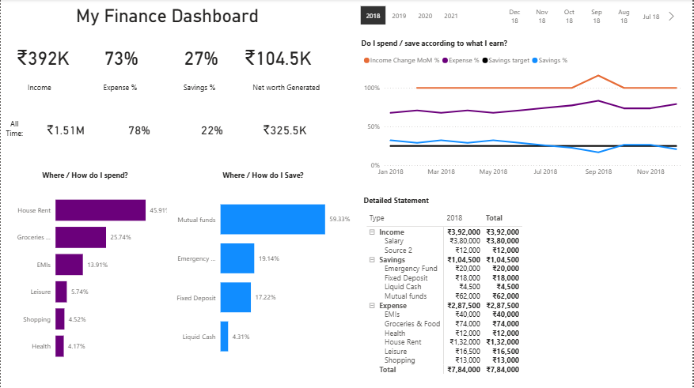
USER INTERFACE DESIGN
Dashboard Layout & Visual Components
Executive KPI Headers
Income (₹392K), Expense % (73%), Savings % (27%), Net Worth (₹104.5K).
Expense & Savings Breakdown
House Rent (45.91%), Mutual Funds (59.33%), Emergency Fund & FDs.
MoM Spend & Statement Matrix
Dynamic monthly trend lines paired with itemized statement tables.

Slide 6
DATA INSIGHTS
Key Metrics & Financial Allocation
27%
45.9%
59.3%
Savings Rate
House Rent Share
Mutual Funds SIP
₹104.5K Net Worth generated
Largest individual monthly expense
Primary asset allocation channel

Slide 7
PROJECT OUTCOMES
Strategic Business & Analytical Impact
Data-Driven Decisions
Automated Workflows
Portfolio Showcase
Enabled clear visibility into spending behavior and investment capacity.
Eliminated manual monthly aggregation with automated Power Query ETL.
Demonstrates end-to-end Power BI capabilities for data analytics roles.

Slide 8

Thank You!
Questions & Technical Discussion
Power Query ETL
DAX Modeling
Power BI Visuals

